Slide 1



Road Accident Dashboard
This presentation introduces a new road accident dashboard project aimed at helping key stakeholders gain deeper insights into road accident trends over the past two years.

Slide 2


Purpose and Stakeholders
Purpose
Stakeholders
The main objective is to provide stakeholders with deeper insights into road accident trends over the past two years.
The Ministry of Transport, Road Transport Department, and Police Force will be the key stakeholders for this project.

Slide 3
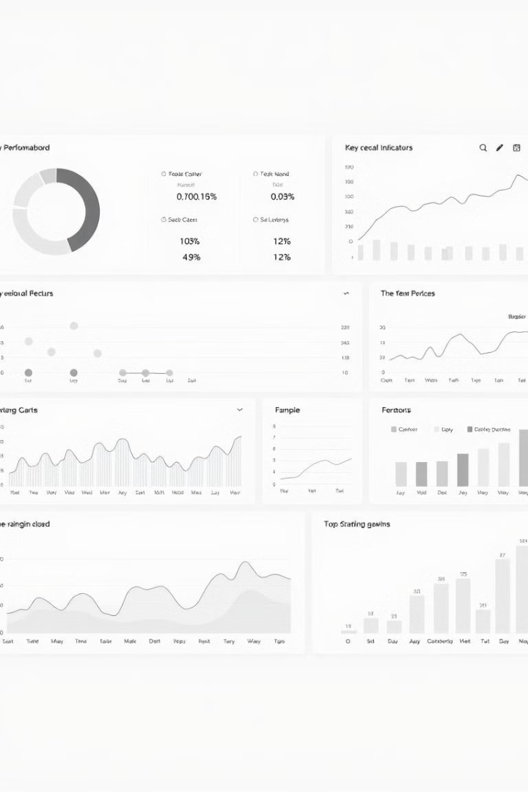
Data Sources and Preparation
Data Sources
Data Preparation
We have gathered data from various government agencies and law enforcement to create a comprehensive dataset.
The data has been cleaned, standardized, and integrated to ensure consistency and accuracy.

Slide 4



Data Modeling and Relationships
Accident Data
Demographic Data
We have modeled the accident data to include details such as location, time, severity, and contributing factors.
Demographic data on drivers and victims has been included to understand the human factors involved.
1
2
3
Road and Vehicle Data
We have also incorporated road infrastructure and vehicle details to analyze their impact on accidents.

Slide 5
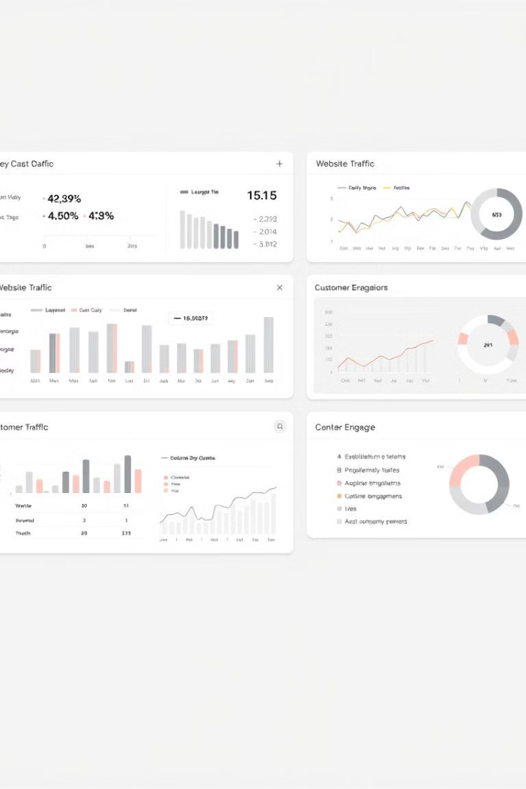



Dashboard Walkthrough
Geographical View
Explore accident hot spots and patterns across different regions.
Trend Analysis
Analyze accident trends over time and identify emerging patterns.
Vehicle Analysis
Understand the role of vehicle type and condition in accident causation.

Slide 6
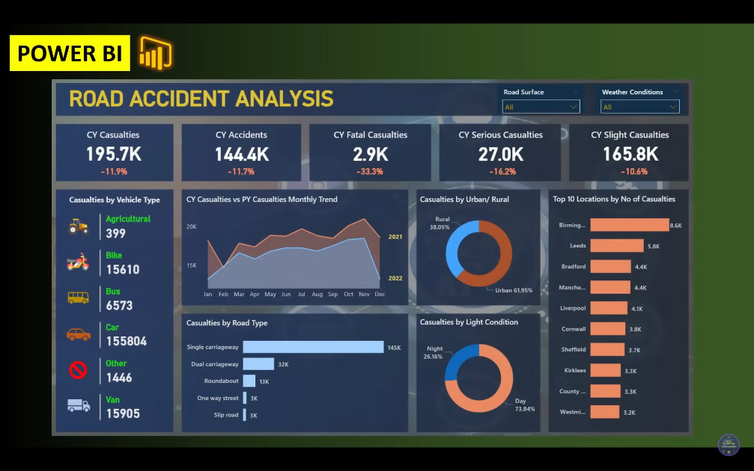


Slide 7





Key Insights
1
Speeding and Distracted Driving
2
Road Infrastructure Gaps
3
High-Risk Demographics
Our analysis has revealed several key insights, including the significant impact of speeding and distracted driving, the need for infrastructure improvements, and the identification of high-risk demographic groups.

Slide 8


Recommendations
1
Enforcement
2
Education
3
Infrastructure
4
Monitoring
Based on our findings, we recommend a multi-pronged approach involving stronger enforcement, public education campaigns, infrastructure upgrades, and continuous monitoring to address the root causes of road accidents.

Slide 9

THANK YOU
This road accident dashboard project has provided valuable insights into the trends and factors contributing to road accidents over the past two years. By addressing these insights, we can work towards reducing the loss of lives and the significant economic costs associated with road accidents.
We're happy to answer any questions you may have.

